Slide 1
WINNING RESUMES & SOCIAL MEDIA IN YOUR JOB SEARCH
OUTCOMES DENVER
Winning Resumes & Using Social Media in Your Search

Slide 2

WHAT WE’LL COVER TODAY
Your Resume
Top Resume Tips
The Format
The Do Nots
Resume optimization services & Applicant Tracking Systems
Branding & your resume
Social media & the job hunt
Blogging
(Ideally) resume drafting party

Slide 3
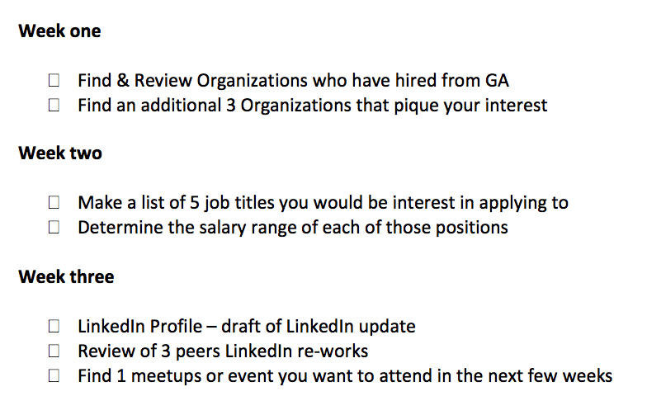
Homework - What should be done by now

Slide 4
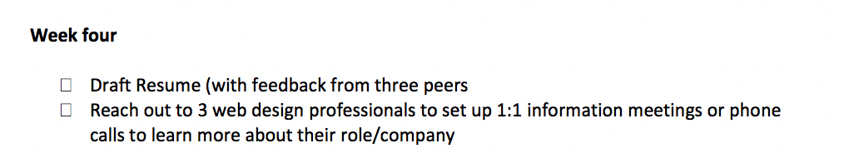
Homework - Due April 18th
)

Slide 5
RESUME: THE SECRET 6
Your resume should be an advertisement – not an autobiography
Write for the reader – not yourself
Make it easy to be screened in – not out
Tell them only what they want to hear
Give proof – not promises
One size does NOT fit all situations
Do your research - your resume is your personal advertisement

Slide 6
RESUME: TIPS + TRICKS
R+R: Fill it with as much Relevant & Recent content as you can
Make it reflect your personality (it shouldn’t sound like a “How to write a resume” book)
Condense your verbiage
Use a modern, professional Font (Helvetica, Didot, Verdana etc.)
Clean lines & aesthetically pleasing resumes win!
Be consistent on format (ex: if you Bold one title, bold them all)
Proofread, Get a 2nd/3rd/4th opinion
Download Grammarly in your Chrome browser
Know that it is YOUR resume

Slide 7
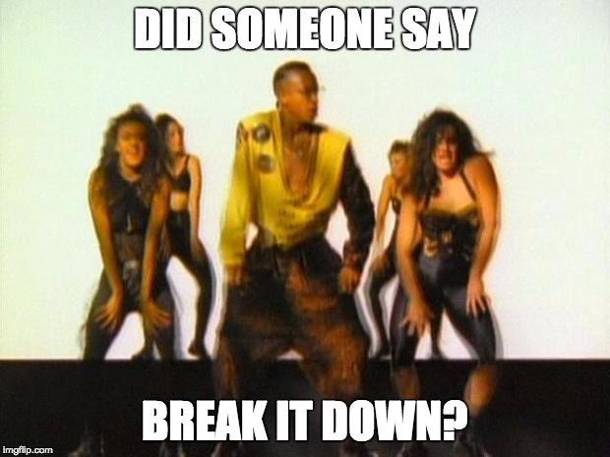
RESUME: LET’S BREAK IT DOWN

Slide 8

RECRUITERS: WHAT MAKES A STRONG RESUME?
Listing your accomplishments, metrics, and core competencies in the job description, not your day-to-day responsibilities
Keeping it to 1 page only
Trimming description of non-relevant roles
Listing your new skills near the top of the page
Formatting resume in a cohesive way where it tells a story + easy to read
Writing in an active voice and not repeating action verbs
Removing: Photo, Address (street, house number), Graduation Year, GPA, References.
Sending a PDF version or Word Document

Slide 9

CONTENT HIERARCHY
INTRO Name, Phone, Email, Website, LinkedIn
TITLE UX Designer | UI Designer | User Experience Specialist
LOCATION: City, State, Zip code
SUMMARY: Personal Brand Statement | Elevator Pitch 2.0
SKILLS Personas, user stories, prototyping, user research
PROJECTS Include GA coursework here (title, intent, skills/tools used)
EDUCATION School/degree, GA certification, (if PH.D list after SKILLS section).
INTERESTS (optional) : Only those with a direction relation to position (UX meetups, outside projects, coding classes, etc.)
Notes:
Yes: LinkedIn, Github
Maybe: Instagram, Twitter, Blog
No: Facebook, YouTube, Etsy, YouTube
Current / Relevant Experience
GA usually goes here (as well as in Education section) Legally, you do not have to put the date you graduated - that’s ageism!
Past experience - what do I include?
Depends on…
how it relates to the position you’re applying for
how much past experience you have to show
It will be different for each person in this room

Slide 10
YOUR RESUME : THE BASICS
CONTACT INFO
Name
Location (optional)
Phone Number
Email Address
Links [Linkedin, Portfolio, Website, etc.]
SUMMARY
Who are you?
What do you do?
What can you do for them?
Why you?
EDUCATION/TRAINING
Include GA and additional educational institutions
SKILLS
Add technical skills that make sense for your search.
It’s okay to have a skills section, but also show how you used your skills when writing the descriptions of your roles/ projects
EXPERIENCE
Add in chronological order
Avoid having gaps
Keep content concise & relevant
HONORS/AWARDS
If relevant and true, unique or prestigious awards
ACTIVITIES
Add any industry specific organizations/affiliations.
It’s okay to add a few “Outside of work” activities so recruiters get to know you, but use your professional judgement and know your audience before adding.
EXTRAS
Logo
Designs
Customized layout

Slide 11
YOUR EXPERIENCE:
ADDITIONAL EXPERIENCES
(Tip: Label your additional experience section a name that makes sense. For example, if you come from a background where you managed teams, you can call this your MANAGEMENT EXPERIENCE section).
Example:
MANAGEMENT EXPERIENCE
Company Name, Your Job Title, Location, Months & Dates
Add descriptive bullet points exemplifying your experience and accomplishments
(Tip: Focus on the highlights. Which of your previous duties are transferable to UX design?)
Add descriptions that show achievements and work duties that can be “monetized”
(Tip: Incorporate measurable results such as number of employees oversaw and percentages of revenue you helped increase)
Add descriptions of notable tasks, increases in responsibility, or shifts in role
(Tip: Write out your descriptions as you would say them out loud, then go back and tweak it to sound professional as this prevents an overload of resume jargon)

Slide 12
WRITING SUCCESSFUL BULLETS:
Begin with strong action verbs (Developed, Created, Designed, Managed, Led), and be sure to vary them
Be specific with your content
Remember to provide proof...show the data. Don't just say "Led a team". Rather, "Led a team of five to achieve a growth rate that increased revenue 80%"

Slide 13
TEST YOUR KNOWLEDGE -
KEEP OR TOSS?

Slide 14
6 SECONDS
https://resumegenius.com/6-second-resume-challenge

Slide 15
FORMATTING & OPTIMIZING

Slide 16
RESUME: CREATING YOUR FIRST DRAFT
Job seekers in Tech & Creative fields have the ability to submit more non-traditional resumes. Here are a few resources for building your resume:
Canva.com (Free)
KickResume.com (Some free/$4 a month for all versions)
Represent.io
Vizualize.me
CreativeMarket.com ($6 and up)
FYI, you can create any of these designs in Illustrator or InDesign etc., but these are quick and easy to use.
Honestly, I hate all of these as there is nothing wrong with a well-written & developed Word doc but I figured I would share the options others have used.

Slide 17
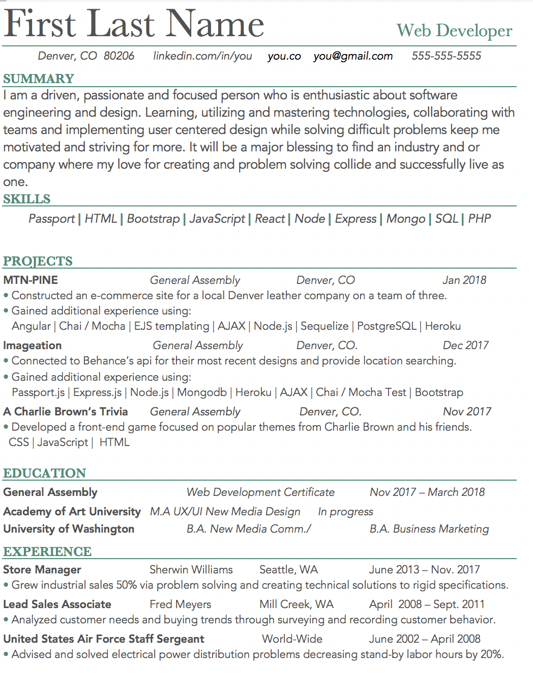

Slide 18
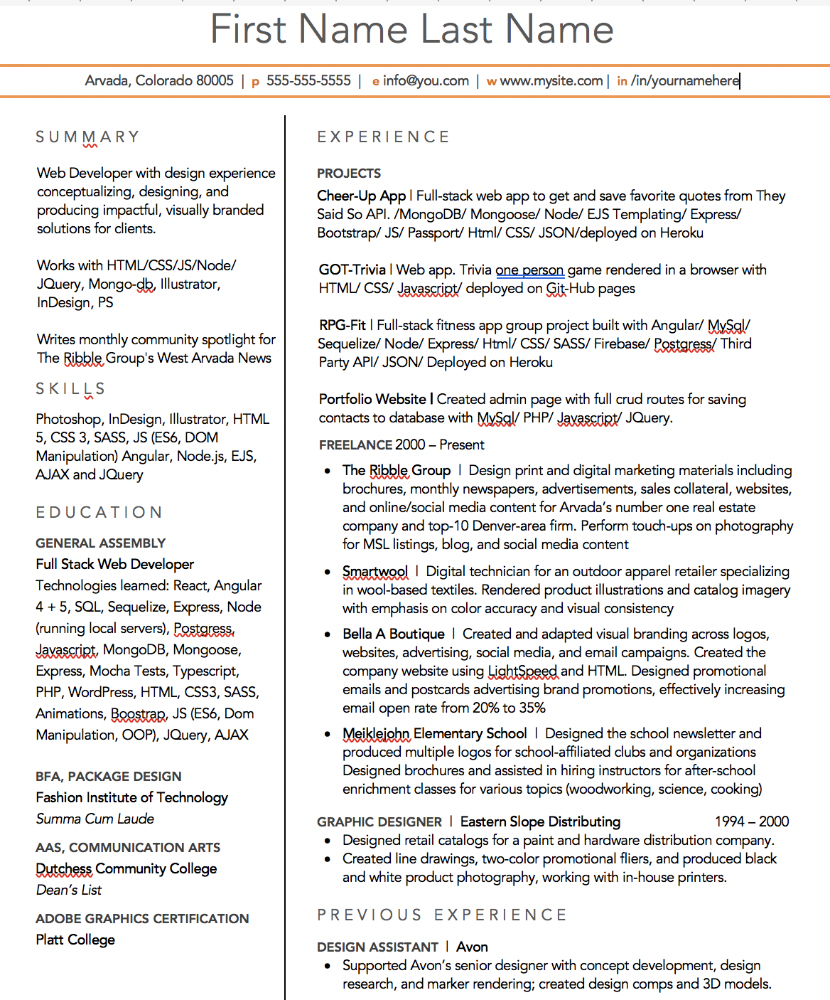

Slide 19
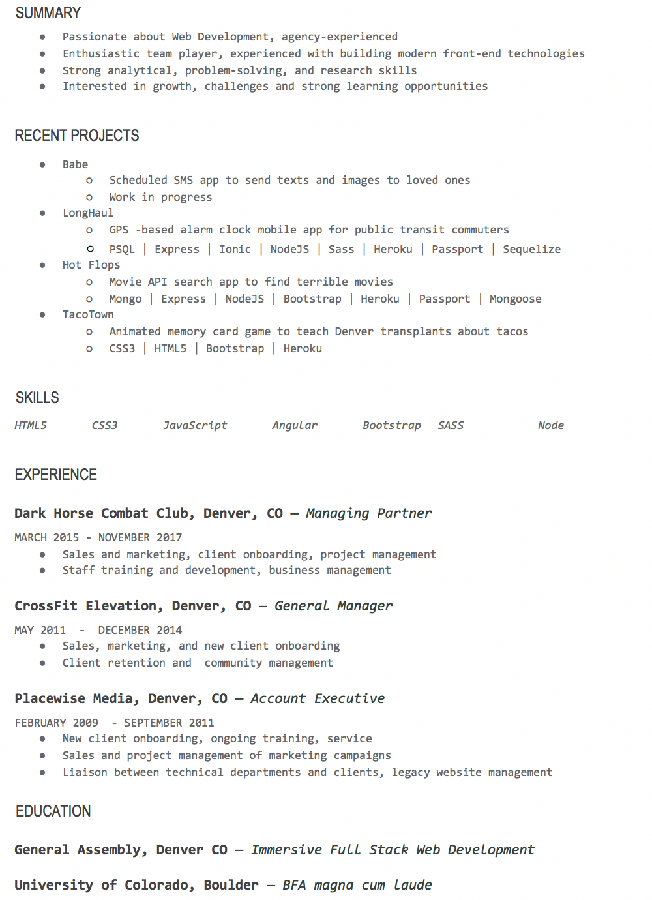

Slide 20
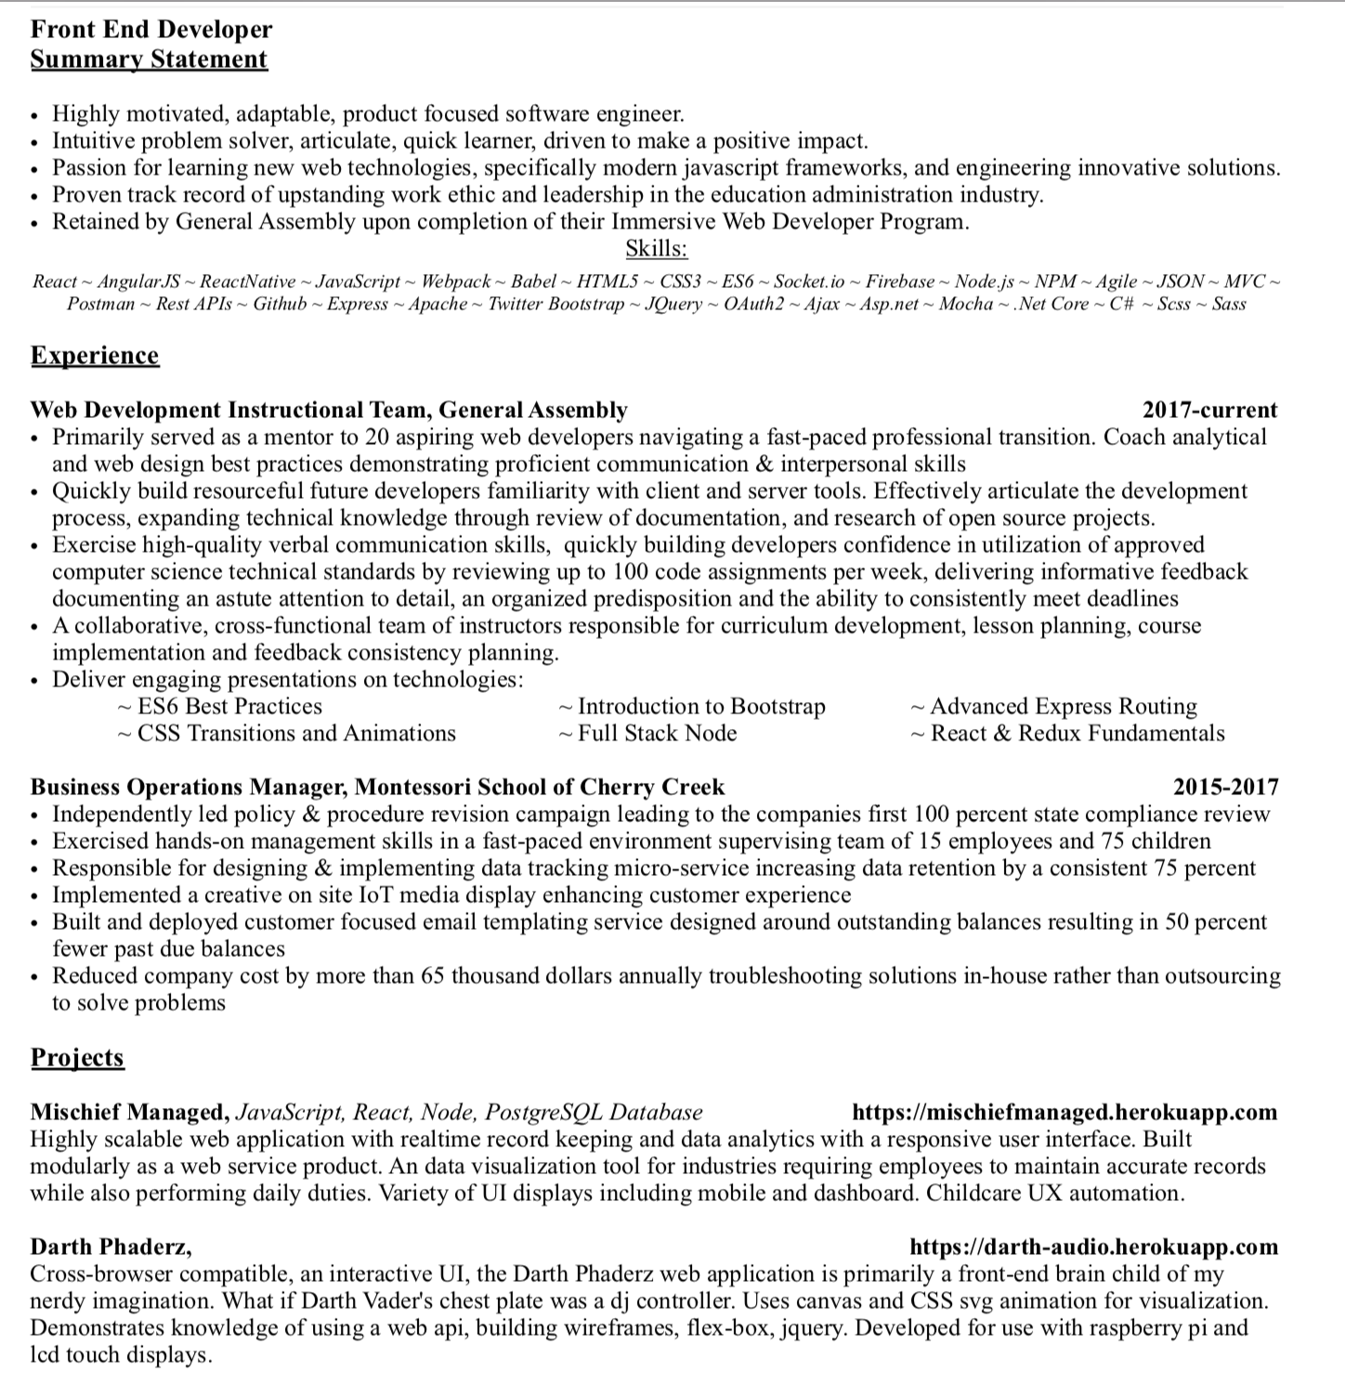

Slide 21
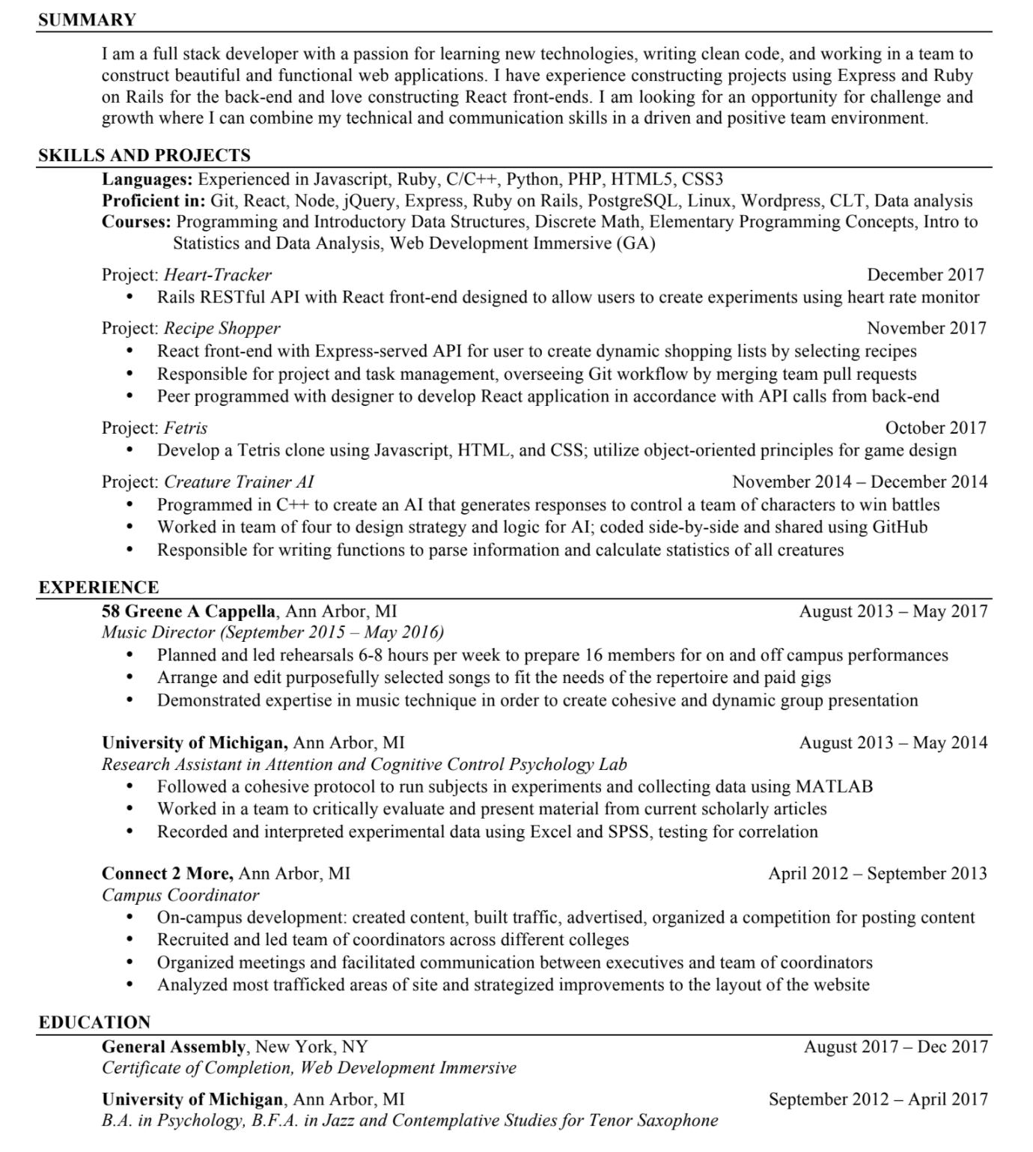

Slide 22
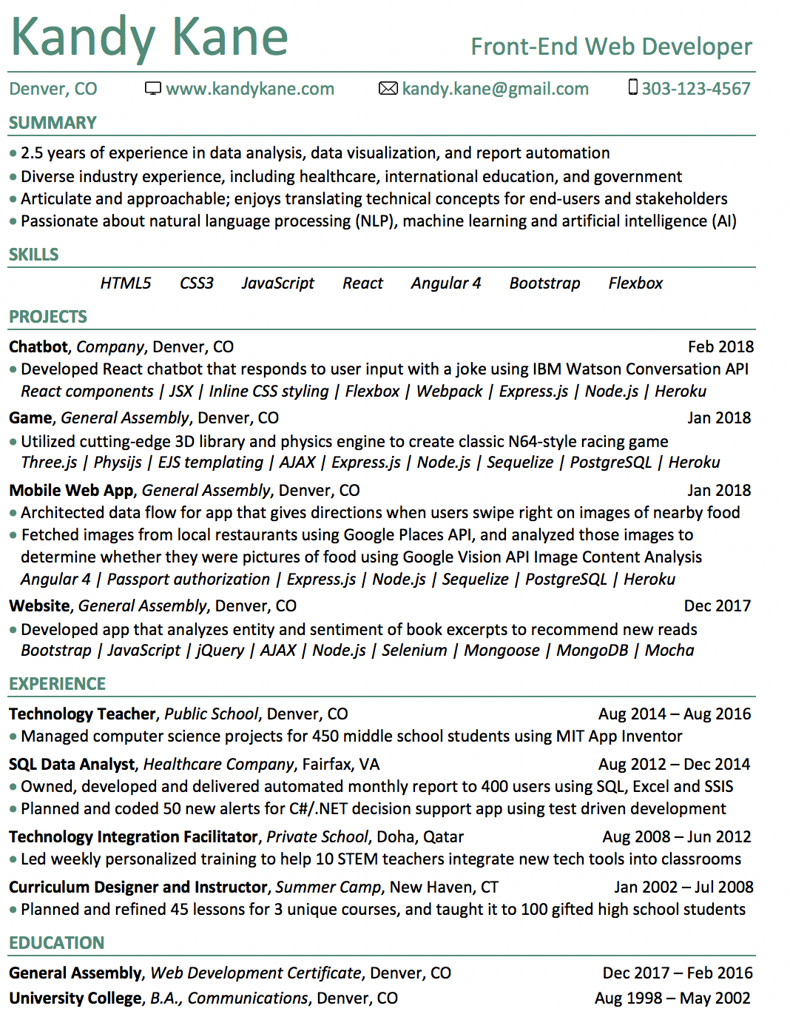

Slide 23
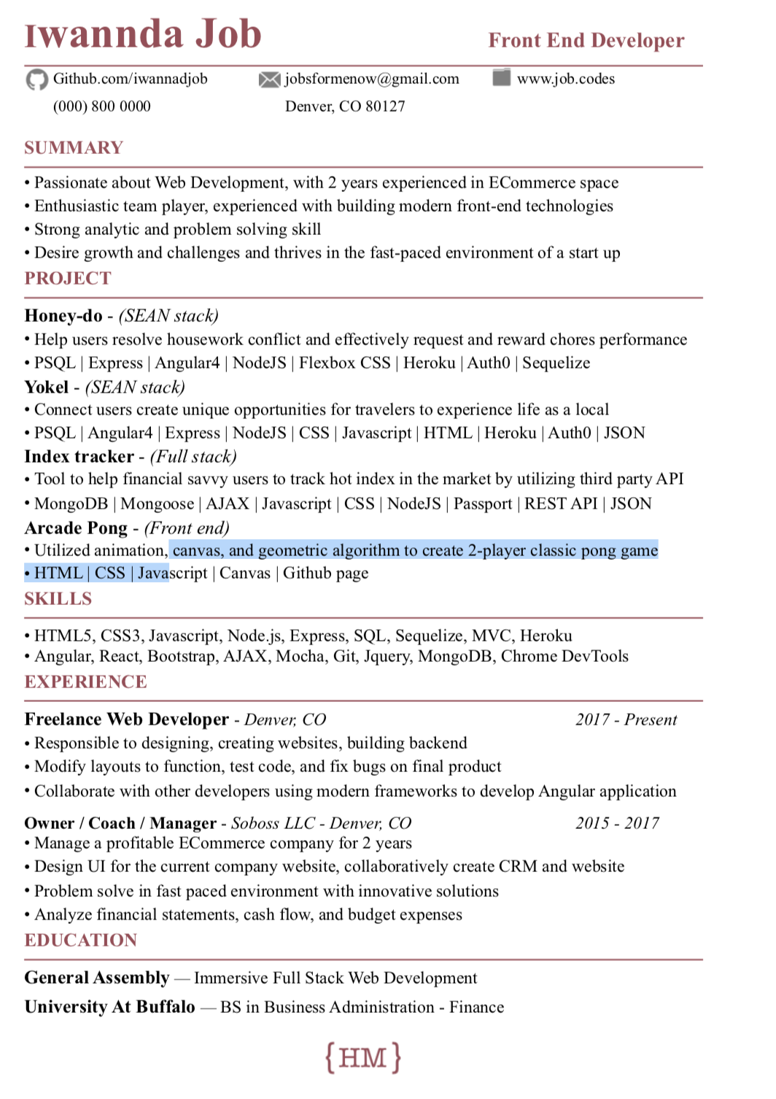

Slide 24
Applicant Tracking Systems:
How to make them your friend vs. your foe

Slide 25
APPLICANT TRACKING SYSTEMS
What is an applicant tracking system (ATS)?
An applicant tracking system is used by companies to screen potential candidates based upon submitted resumes and applications.
How does an ATS impact my chances of hearing back from a company?
When a hiring manager or recruiter creates a job posting, they submit it for review via an ATS. In listing their posting, the hirer has selected a list of “keywords” that they expect to see (or a percentage of) in the submitted resume. If a resume does not have enough of the keywords from the job posting, it will go into the “resume black hole” and will never be seen by human eyes. Other elements such as years of experience, type/extent of education, and industry may also be screening areas.
What words do I include to get past the ATS?
Action verbs, industry-specific terminology, programming languages, position-specific skills

Slide 26
OPTIMIZE YOUR EFFORTS BY SCREENING YOUR RESUME
The following services will help you boost your resume and make it relevant to the dreaded applicant tracking system (ATS)
Job Scan: An online service scans résumés and compares them with the keywords in specific job description -- we have a discount to this service. For outcomes with me, it is mandatory.
CV Lift: Gives a list of commonly found words in job descriptions
RezScore: Scores resume & provides feedback on how to improve
WHY USE THESE SERVICES?
It helps you optimize your resume. The more effectively you can tailor your resume for a specific job, the better your chances are.
Generic resumes are a dime a dozen, and unlikely to do well in an ATS. Using these services, you can easily optimize your resume against any job description and make yourself a top candidate.

Slide 27
Resume DO NOTS!

Slide 28
Things to not include in your resume
A long list of job experience
Recruiters do not need to know your entire work history —it’s best not to have a long list with every single company you’ve ever worked at. Instead, you should only list the previous jobs that are relevant to the position you’re applying. If you do not have much experience, take specific tasks you’ve had at those previous jobs and relate them to the job you are applying for.
Anything that’s not true
If for some reason your work experience isn’t verified by the recruiter, it is very likely that the truth will come to light during the interview. In this case, not only would you lose out on the position, you will probably be barred from applying for future positions.
Private/Personal information
Information about your personal life, such as sexual orientation, political affiliation, religious affiliation, marital status, age, etc. should be completely left out of your resume

Slide 29
Excess and unprofessional contact information
When you are including information on your resume for ways you can be contacted, you should simply include one phone number and one email address. Typically, the email address you provide should be some variation of your name.
“References available upon request”
Though this may be your way of sounding enthusiastic about the position and willing to continue contact, at best this will be seen as presumptuous to a recruiter. Overall, your resume is precious real estate—don’t waste any space by including this phrase or listing out references.
Spelling errors or bad grammar
One of the worst mistakes is to include mistakes on your resume —unfortunately these can be the easiest to make. After staring at the same document for a prolonged period of time it can be very easy to miss any mistakes you might have made. There are two easy ways around this. The first is to walk away for a few hours and then come back with fresh eyes. The second is to ask someone to take a quick look at your resume and point out any mistakes you might have made.

Slide 30
Don’t Include Obvious Skills
Because everyone assumes you know how to use Microsoft Word--and the internet. Use your valuable resume space to highlight skills that actually make you stand out.
Don’t Include Work With Controversial Organizations
Maybe that volunteer work was fundraising for a politician, or answering the phone at a LGBT-resource organization may be difficult to frame on a resume. However, you also need to assess the importance of an organization aligning with
Don’t Include Random, Unrelated, or Off-Putting Hobbies
That said, remember that hiring managers probably don’t care if you love basketball, are active in your book club, or are a member of a Dungeons and Dragons group. Eliminate anything that’s not totally transferable to work-related skills (or a really, really epic conversation starter).

Slide 31
Don’t Use an Objective Statement
There’s only one situation in which you need an objective statement: when you’re making a huge career change. Making the leap from, say, business development to marketing means your resume could definitely use a clear explanation that you’re transitioning roles and have the necessary transferable skills. But if you’re a PR rep applying to a PR firm, an objective statement will just waste valuable space.
Don’t Use Clichés or Jargon
Because hiring managers are really, really tired of seeing descriptions like hard worker, team player, or detail-oriented on resumes. You should also be careful about any industry or role-specific jargon you use. In many companies, if you want to your resume to land on the hiring manager’s desk, you’ve got to get it past HR first—which means putting everything in terms a layperson can understand.
Don’t Use Negative Phrases
You should also be careful of using words with negative connotations—even if you’re using them in a positive light. Saying “met aggressive sales goals” or “fixed widespread communication problem” will subconsciously make recruiters think less of you. Instead, write “delivered on ambitious number of sales” or “proposed and implemented solution to make company communication easier and more efficient.”

Slide 32
Don’t Include Anything That Could Be Discriminated Against
While it’s illegal to discriminate against a job candidate because of his or her age, marital status, gender, religion, race, color, or national origin, it doesn’t mean it doesn’t happen subconsciously. Don’t give recruiters the chance, and just leave these details off.
Don’t Use More Than 2 Fonts
And really, it’s best to stick to one basic font. Unless you’re a designer and know a lot about typography, it’s easy to choose fonts that clash or are distracting.
Don’t Go Overboard With Text Effects
If every other word is bolded, italicized, or in ALL CAPS, at best, your resume will be distracting—at worst, annoying. Use emphasis sparingly, for your most important info.

Slide 33
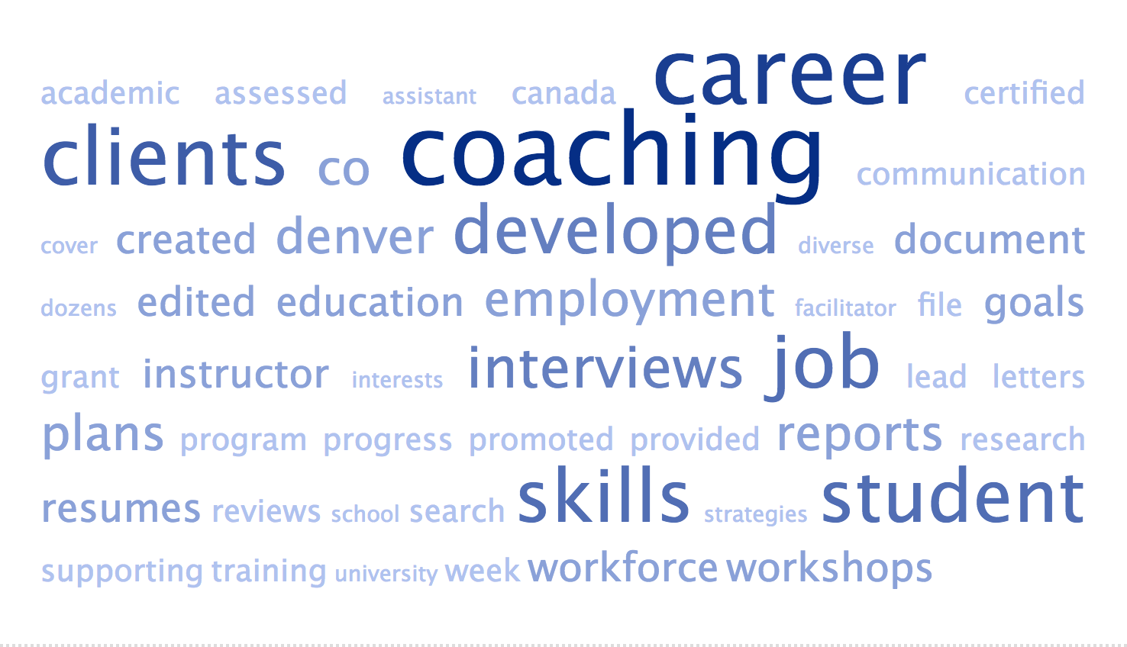
Don’t Send the Wrong Message
Want to make sure you’re spending enough time on the right things in your resume? Run your resume through a word cloud generator like TagCrowd.
This will create an image representing the most frequent words, with the most common ones showing up larger and darker. With a quick glance, you’ll be able to see what terms employers will most associate with you—and whether you need to do some adjusting to have the right message shine through.

Slide 34
Your resume should not be all encompassing
There is no such thing as a one size fits all resume. If you try to include your experience as a sales associate, chef, entrepreneur, and circus clown you will end up with a resume that lacks focus and therefore will not be an effective tool in your job search. It is not uncommon for job seekers to have a varied career background but when it comes to your resume you need to tailor it to meet the specifics of the job you are applying for.
DO NOT USE THE SAME RESUME FOR EACH JOB
There are so many reasons your resume should not be the same for each job—it needs to be tailored to each position, company, segment of your discipline, and more. For each job you have, you should have a slightly different resume that reflect the key words and duties of each position, that demonstrates an appreciation and understanding of the company, and that is specifically targeted at that job title.

Slide 35
RESOURCES - Resumes
The Best Places to Post Your Resume, Depending On Your Field
My Basic Resume Got Me Nowhere, But This Template Lands Me Interviews
An Editor’s Guide to Perfecting Your Resume
The Pain-Free Way to Keep Your Resume Updated and Ready for Anything
How to Tweak Your Resume to Prove You’re the Perfect Fit
5 Ways Your Resume is Just Like Everyone Else’s
CV Vs. Resume - Here Are The Differences
4 Ways You Can Always Improve Your Resume (No Matter How Good It Is)
Here’s One Way to Stand Out When You’re Competing with Hundreds of Qualified Candidates
How to Create a Kick-Ass Resume You Can Send to Anyone Who Asks for It
Is a Two-Page Resume Ever OK?
This Simple Formula Makes Highlighting Transferable Skills Easy
185 Powerful Verbs That Will Make Your Resume Awesome
How to Add Experience to Your Resume (Without Adding a Page)
6 Pro Tips for Cutting Your Resume Down to One Page
How to (and How Not to) List Education on Your Resume
The 5 Minute Resume Rundown You Need (Checklist Included!)
What it Really Means to “Tailor Your Resume”
The Perfect Resume - How to write one and land your dream job
6 Bizarre Resumes - And What You Should Learn From Them
The Undercover Recruiter: 5 Tools for Creating an Infographic Resume
9 Key Things the Hiring Manager is Looking for on Your Developer Resume
How to Embrace the Most Embarrassing Parts of Your Resume
How to Quantify your Accomplishments

Slide 36
DIGITAL PRESENCE
CREATING A CONSISTENT BRAND

Slide 37
CREATING A CONSISTENT BRAND
All of your professional online accounts should have a consistent look and feel.
Your professional email, portfolio & social media should all use the same headshot.
Have a modern email that is a combination of your first and last name.
No AOL or Hotmail.
Absolutely no Yahoo -- it’s been hacked SO MANY TIMES
Email signatures are important. At a minimum, include your phone number, portfolio/personal website url, and LinkedIn url.

Slide 38
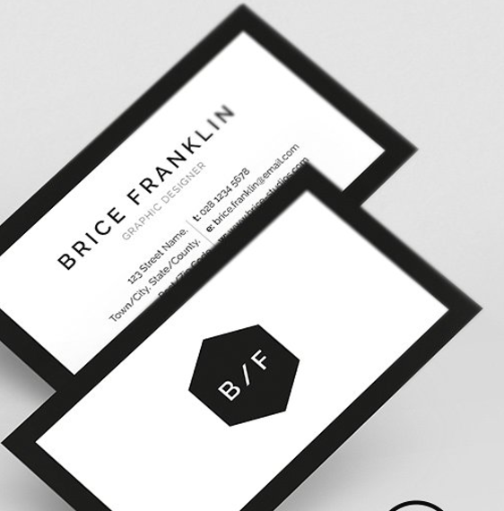
BUSINESS/NETWORKING CARDS
Many sites that allow you to build a resume will have matching templates for business cards. It’s good idea to have a few on hand. When you design your business card, have it’s colour scheme, visuals (if anything) or personal branded image, match your other professional documents or online presence.
Canva.com (Free to design)
Moo.com
Staples - 500 for $14.99
Office Depot/Max

Slide 39
What should be on your networking/business/contact card?
Name!
Desired title (UX/UI Designer, UX/UI Researcher, etc.)
Phone number
Email
LinkedIn URL (make sure its a tailored one--the shorter, the better)
Website

Slide 40
DIGITAL PRESENCE
SOCIAL MEDIA

Slide 41
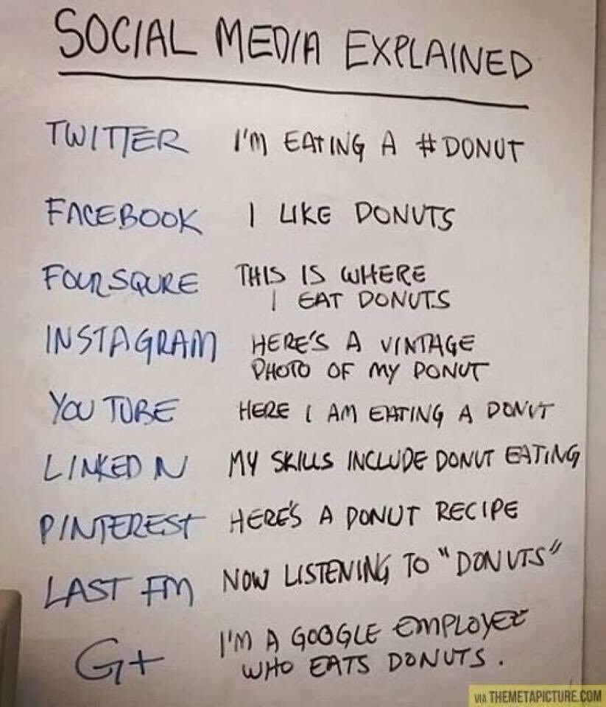





SOCIAL MEDIA
How to sum up social media:
LinkedIn is people you know
Facebook is people you used to know
Twitter is people you want to know
Instagram is the stuff you have
Pinterest is the stuff you want

Slide 42
SOCIAL MEDIA
Get online!
73% of recruiters have hired a candidate through social media.
93% of hiring managers will review an applicant’s social media profile before taking the next step.
55% of recruiters have reconsidered candidates based on their social profiles, 61% of those reconsiderations being negative.
23% found content that directly led to hiring the candidate.
Candidates sourced through referrals and company hiring pages are more likely to get hired faster, and stay longer. [Source: 2015 Jobvite Survey]

Slide 43
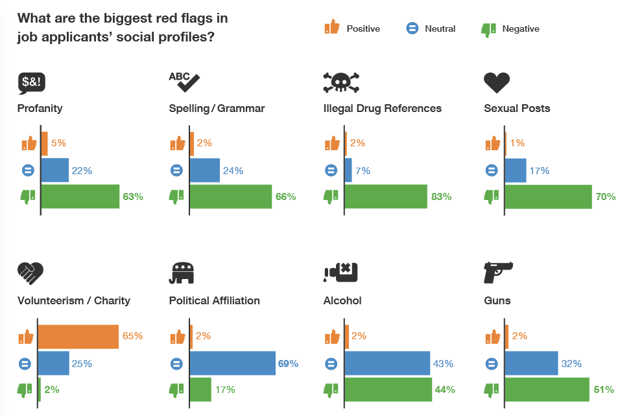
SOCIAL MEDIA

Slide 44
DIGITAL PRESENCE
BLOGGING / THOUGHT LEADERSHIP

Slide 45
BLOGGING / THOUGHT LEADERSHIP
Why?
Being seen as somewhat of an expert in your field goes a long way to raising your online presence and personal brand
Contributing in some shape or form online is a great way to build additional credibility
It’s a brilliant way to network with people and to engage in meaningful dialogues in things you are interested in and passionate about

Slide 46
BLOGGING / THOUGHT LEADERSHIP
How?
Find a forum and post comments to discussions.
Use LinkedIn to write posts and share articles.
Medium is a great tool for writing and sharing as well.
Use your own personal website to blog and then use twitter to send people to your new blog posts.

Slide 47
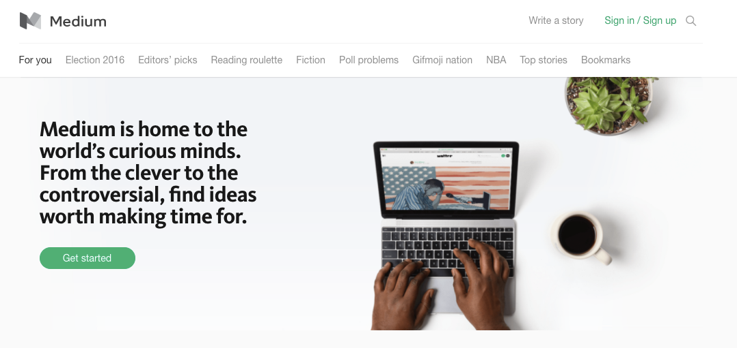
BLOGGING / THOUGHT LEADERSHIP

Slide 48
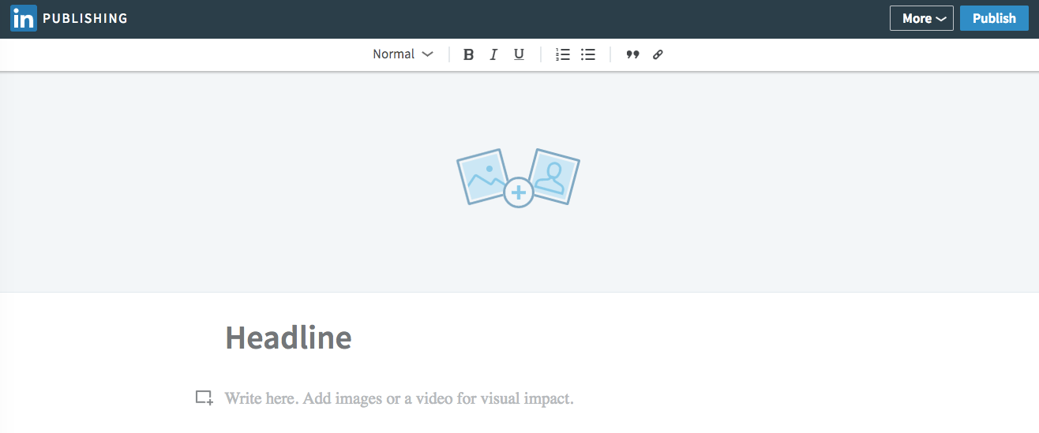
BLOGGING / THOUGHT LEADERSHIP

Slide 49
BLOGGING / THOUGHT LEADERSHIP
Example Process
Write post on Medium.
Shorten copy & post on LinkedIn.
Add link to post on portfolio.
Compose tweet to drive traffic to portfolio.

Slide 50
DENVER OUTCOMES - RESUMES & SOCIAL MEDIA
THANK YOU!
Nicole Palidwor
CAREER COACH
EMAIL: nicole.palidwor@generalassemb.ly
SLACK: career.coach.nicole
ARTS WITH THE END!

